Slide 1


Price Prediction On ML Model of Mobile Phones
Bharti Jagyasi

Slide 2

Agenda
key features that influence the prices of mobile phones.
To build a predictive model that can accurately estimate the price of a mobile phones

Slide 3
Engaging the audience
Linear Regression models -:These models can provide valuable insights into the linear relationships between features and pricing, serving as a foundation for more complex modeling techniques.
Random Forest models-: These techniques can effectively handle complex relationships and provide robust performance in pricing prediction tasks..

Slide 4

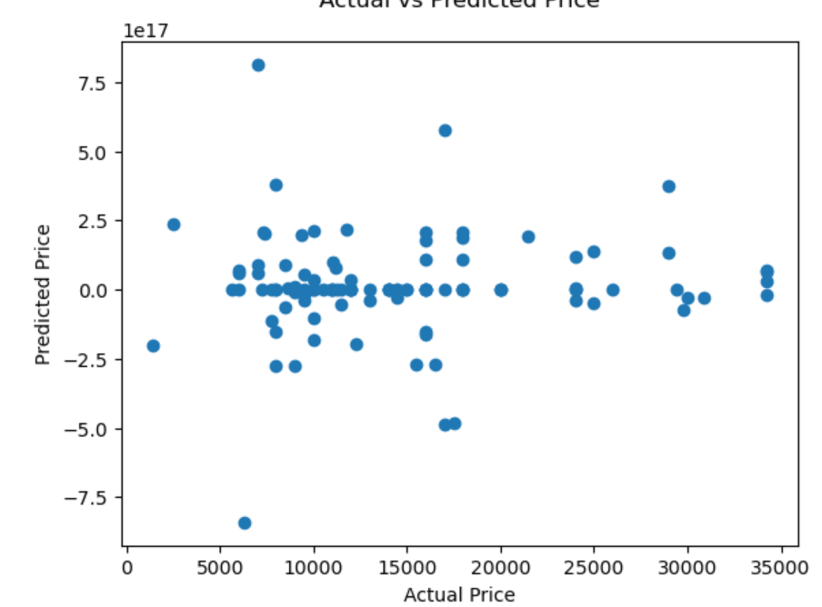
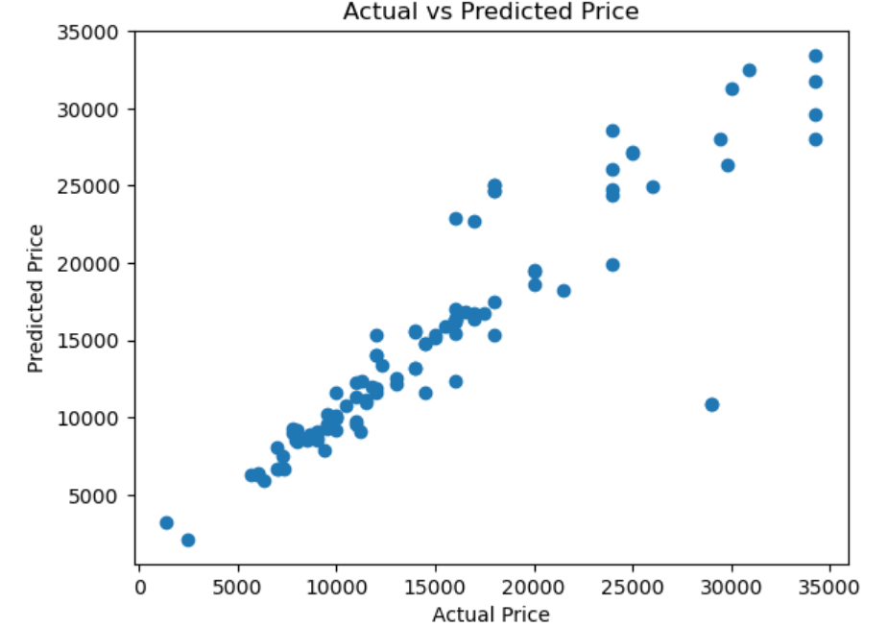
Random forest
Linear Regression

Slide 5
Evaluating Performance
The root mean squared error (RMSE)- This metric is particularly useful in scenarios where large deviations from the true price are more costly or undesirable, making it a valuable tool in our evaluation process.
The mean absolute error (MAE) : It is a widely used metric that measures the average magnitude of errors in a set of predictions. By calculating the MAE, we can quantify the accuracy of our models in predicting mobile phone prices, providing a tangible measure of their performance

Slide 6
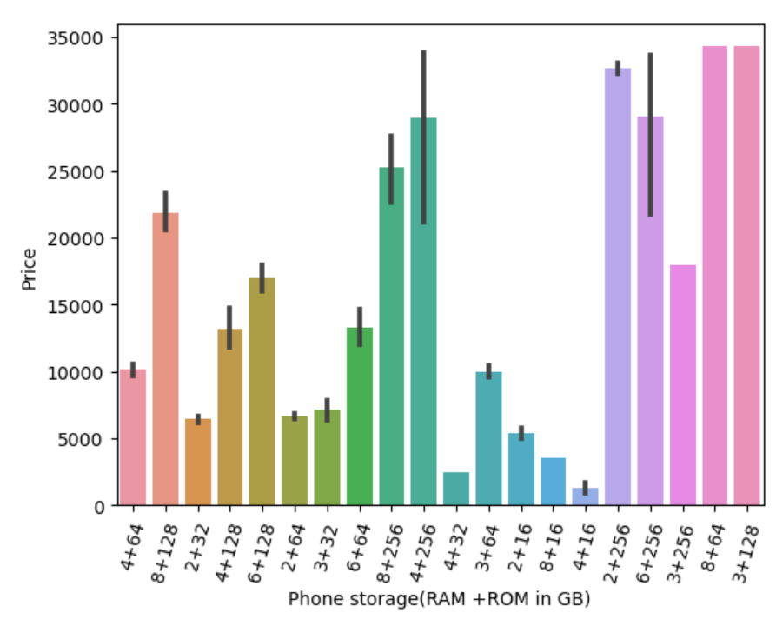
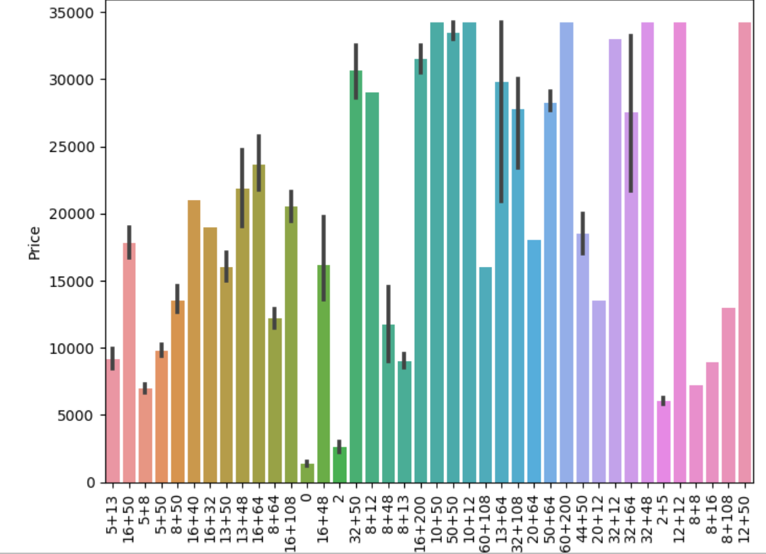
Speaking impact
Mobile price variation with camera quality index in phone
Mobile price variation with memory in phone

Slide 7
Thank you

